Slide 1
Real-Time Cryptocurrency Analysis System
LiangZhihao WangXue
2020-Jun-17
Group 14

Slide 2
Outline
Background & Motivation
Objective
System Architecture

Slide 3
Background & Motivation
Sharp cryptocurrency market volatility
Social media opinion is a good indicator of market price
Real-time data explosion
Real-Time analyzation tool helps decision making

Slide 4
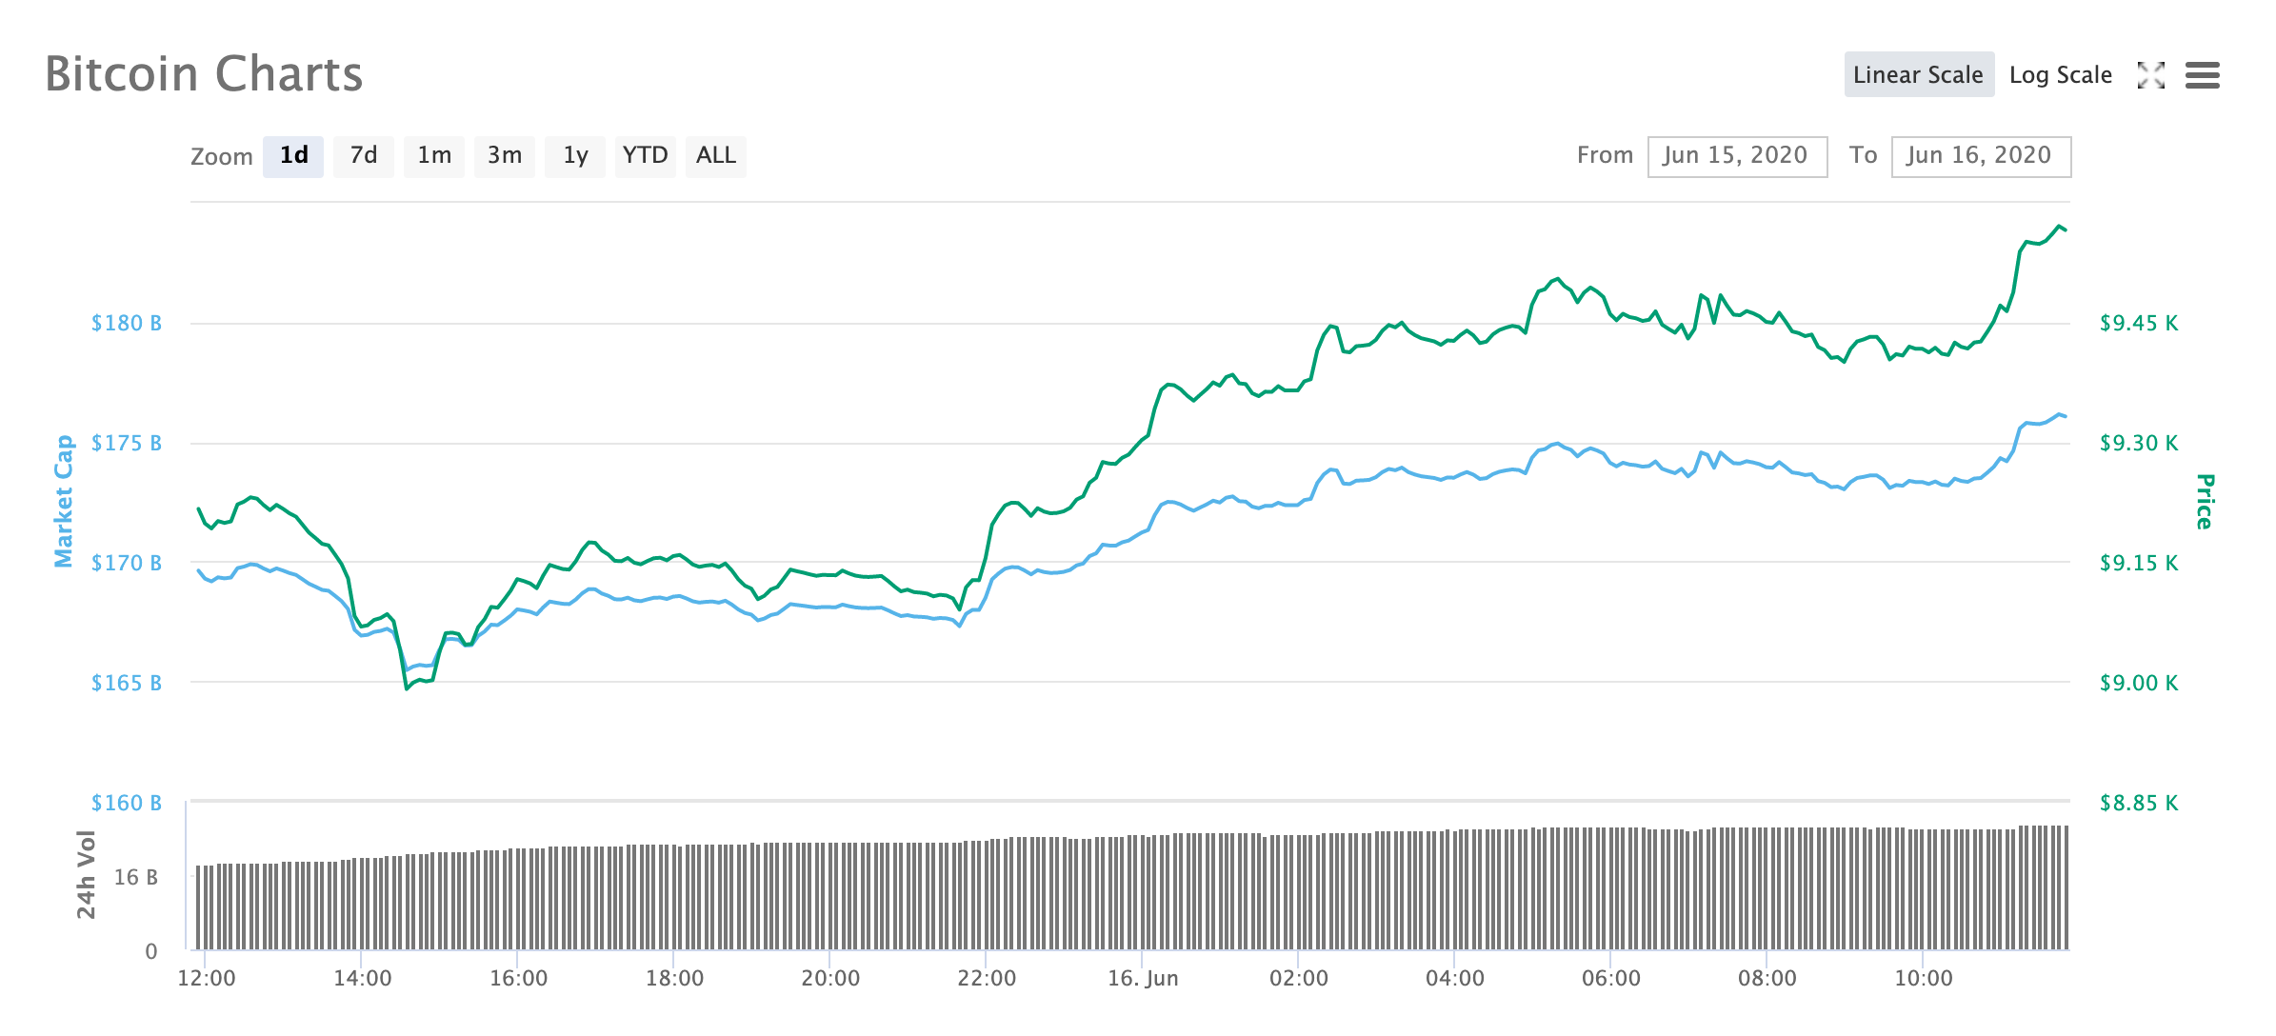
Sharp cryptocurrency market volatility
6.7%

Slide 5
Social media opinion is a good indicator of market price

Slide 6
Big Data Era
1 ZB = 1000⁷bytes = 10²¹bytes = 1000000000000000000000bytes

Slide 7
Real-Time Data Explosion

Slide 8
Objective
Develop a cryptocurrency analyzation system that can handle massive amount of data in real-time.

Slide 9
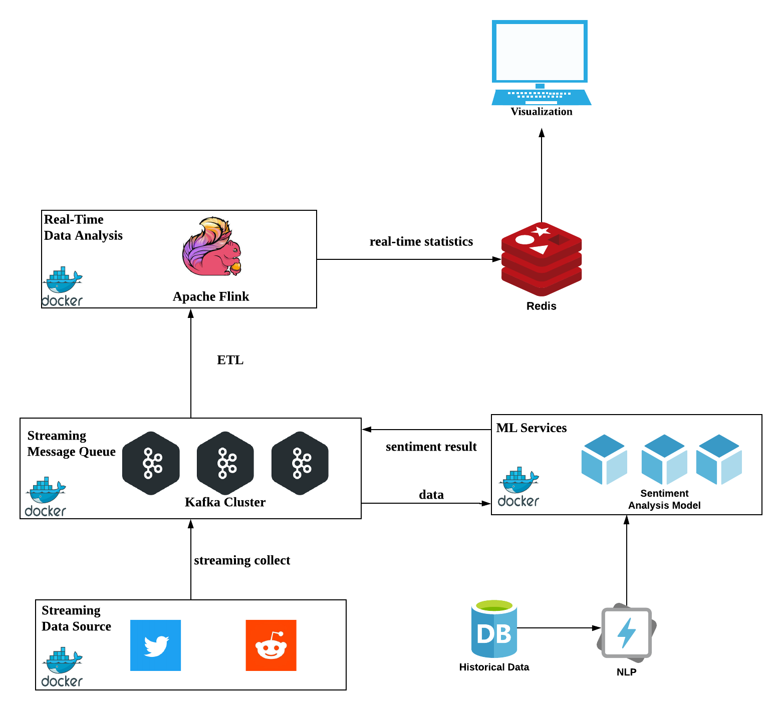
System Architecture

